Slide 1

Rutgers Data Science Bootcamp
The Five Guys Minus One
Project 3 – Natural Gas Machine Learning
October 15th, 2020
Notes:
PATCH
For our 3rd project we tackled some real-world problems that I face daily as a natural gas trader. We are going to show how we have used machine learning to predict powerburn… we will tell you what that is! We will use historical data of storage to help give a sense as to what is possible in forward looking storage. Finally, we scraped storage websites and treated it as a sample to then predict the weekly EIA number. These are all real world applications that could possibly generate P&L. We all like to focus on the PROFIT! Because this is a real world problem we encountered real world road blocks along the way, and we will discuss those as well.

Slide 2

The Five Guys Minus One
Handcrafted Analytics and Py’s since 2020
Resul Cobanoglu
Patrick Patten
Matt Dionne
Derek Leckner
Notes:
PATCH
You know these fools by now, but I am proud to say this was a total group effort with everyone having some real stand out moments. We overlapped a lot on the work and took the best outcome. We will all be talking about what we touched upon.

Slide 3







Technology
Handcrafted Analytics and Py’s since 2020
Notes:
We used the above technology throughout.

Slide 4
1. Project Overview
Notes:
PATCH
We created a project in 3 steps so that we could slowly build up to a larger prediction, larger scale problem. The first 2 steps were a bit more simple in their set up and execution, but still provide critical insights into natural gas trading.

Slide 5
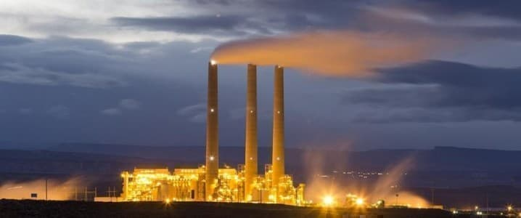
Hypothesis
“There is enough public information scattered around the internet that can be used to predict fundamental demand numbers for natural gas”
Notes:
Patch
There’s almost too much free info, but it’s never in the right form you want it, it’s never easily scraped, timeouts… wha wha wha complain I am going to introduce each problem then a member of the team will get into how it was solved.

Slide 6
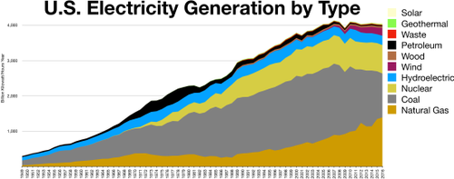
The Parameters of Powerburn
Powerburn is natural gas burned for the purpose of electricity generation.
*We analyzed different limitations on Powerburn to then estimate the forward #.
Notes:
Patch
Powerburn is natural gas burned for the purpose of electricity generation. It is sometimes to referred to as a “spark spread” and spread just means the difference between to prices. Natural gas is measured in dollars per Dth (Dekatherm), that is then converted into electricity which is priced in dollar per MwH (megawatt hour). If gas is really cheap and electricity is really expensive people make money by turning that natural gas into power, however people who make power do have choices.
The chart above shows you all those choices… However Natural gas is about 30% and is based on price, Coal is about 15-20% and again based on price… the rest… some might say they are baseload. Meaning that they are always on when they are on. Once you build a nuclear power plant you’re just the owner of a very expensive complicated tea pot, you’re just boiling water.
Anyways…..
The hypothesis for this step of our project = “It is possible to predict powerburn as a function of input prices, temperature, and how much natural gas is being produced.”

Slide 7
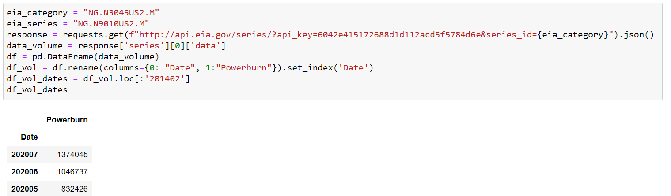
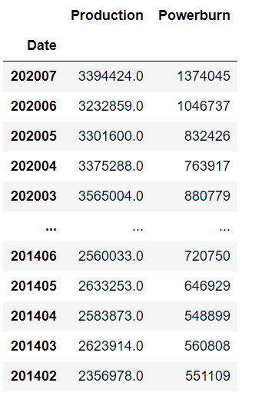
Parameters Code
Going to the EIA website to bring in monthly data of Powerburn.
EIA govt info pulls both Production & Powerburn
Notes:
DEREK
Our parameters from the EIA website are Production – how much natural gas is being produced in the country per month.
We brought this variable in because production of natural gas has increased, its ease of use. Electricity companies have moved more towards using an abundant feedsource. In somewhat of a self fulfilling prophecy if you frack it they will burn it.
The powerburn – the number we are trying to predict also comes from this data source

Slide 8
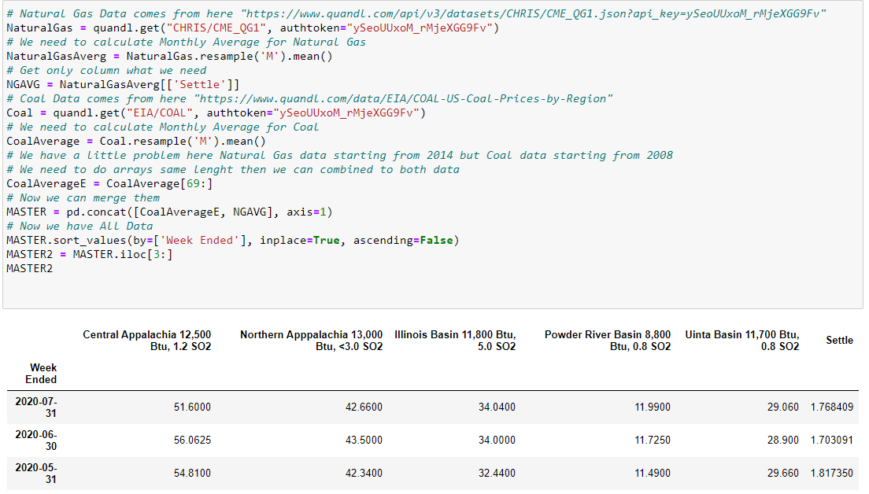
Parameters Code
Notes:
DEREK
Quandl is a public API … Designed for professionals, Quandl delivers financial, economic and alternative data to over 400,000 people worldwide.
We used it to pull in pricing data for coal and natural gas.
The coal prices are for the 4 major trading hubs of coal in the united states. These prices are collected weekly. They are measured in dollars per short ton. The final column on the right is the natural gas settlement, this we took a 7 day average to match up w/ the coal price.
The Natural gas settlement is for gas located in Louisiana, but it is used as the “home base” that many other natural gas hubs trade vs.

Slide 9


Parameters Code – Adding Data
How much gas will be used to create electricity?
Price of underlying (choice)
Coal & Natural Gas
Included Production (growth)
MAKE IT BETTER?
Temperature!
Notes:
DEREK
So we brought that info in and unfortunately only scored about 30% on testing. I was a little bummed out by this number. NG powerburn should go up when NG prices go down relative to the pricing of coal. It should also go up just because there’s more NG today than there was a few months ago…. But it wasn’t enough.
The thought to add temperature as another variable makes sense, as temperatures warm up the need for electricity increases, it might be a more powerful pull on demand than just price. When it gets hot more electricity is produced to turn on AC and while it does come down to price not all of that demand can be explained by just price…..
Anyways… we added temperature, this was the CONUS average temperature for the month.

Slide 10
2. Prediction
Notes:
DEREK
With our data now collated it’s time to predict!

Slide 11
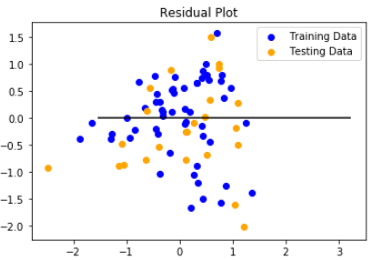

Prediction
We found that with the data collected we are only able to predict slightly less than 50% of activity of Powerburn
Notes:
DEREK
This is a great first try. Adding temperature really increased our scores.
So there are some complications when predicting powerburn that we oversimplified. The price of natural gas isn’t just 1 number. There are over 200 price points in the united states. Furthermore, the price we are pulling in is for the FUTURE month. It still reflects what is happening in today’s supply/demand picture, but not to the most accurate degree.
To better refine this number I could use daily natural gas pricing from a few selected points that are more tied into electricity production. For example TETCO-M3 is pricing point located in Pennsylvania that is tied to over 3k MWH of possible demand. This price would be better to use than lets say Iroquois Z1 which is a pricng point in northern NY on the border w/ Canada which isn’t really connected to electricity pricing at all, it would be more sensitive to heating demand in boston.
However, this model did get better as we added more information to it and I’m certain it would get better w/ more precise data (that currently lives behind firewalls and paywalls)
2nd, I’d also try and derive powerburn from historical natural gas flows and temperature. We could scrape pipeline data that does categorize flows for electricity generation, bring in temperature again and go about a similar prediction. With both predictions in hand a trader could then say if the price prediction and fundamental prediction were to converge does that mean price has to go up or down… a trading opportunity.

Slide 12
3. Forward Look
Notes:
PATCH
Porject 2 - The EIA publishes a weekly number that shows how much gas flowed into or out of storage. The number published Thursday of this week captures the weekly flows from 2 weeks prior. They break this info up geographically.
Our model here isn’t so much a prediction as it is a comparison of this year to year’s prior and it’s an important bit of info for a trader. It can show what’s possible.
We are where we are for natural gas storage today, but if we did the same thing as we did last year where would we be, what about 2 years ago… it’s a way to visualize the data and see what can or can’t be possible.

Slide 13
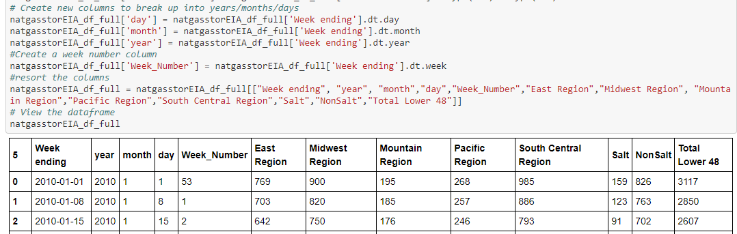
Data Assembly
Again we are pointing towards the EIA API and pulling in a separate set of data.
Notes:
MATT
We have to pull in the data and do a few transformations on it so that we can compare weeks to weeks. We added a week_number column to accomplish that. And yes sometimes there are 53 weeks in a year and they can cause a pain. (There aren’t really 53 weeks in a year, but there can be 53 Thursdays which is where some issues come up.

Slide 14
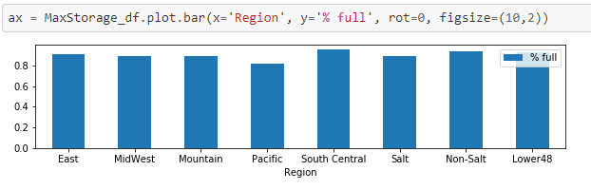
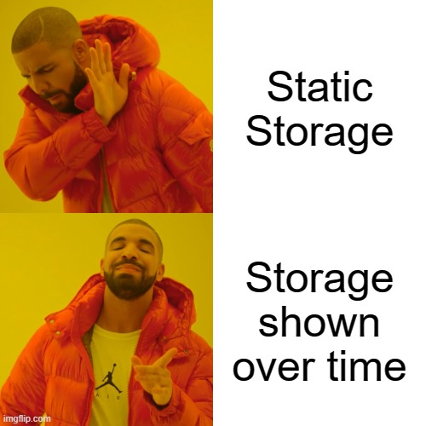
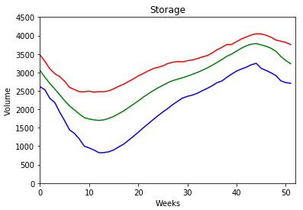
Data Assembly
This is a pretty simple visualization of current storage.
We want to show the max, the min, and current average…..
Notes:
MATT

Slide 15
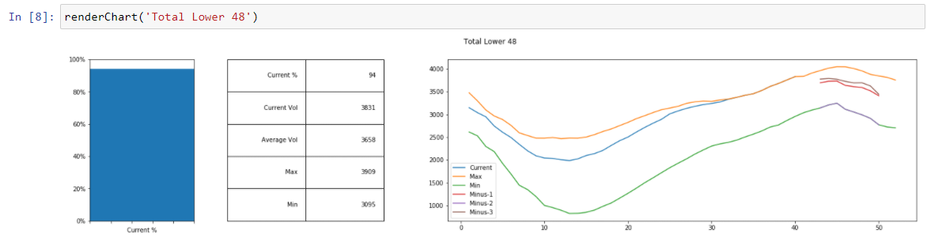
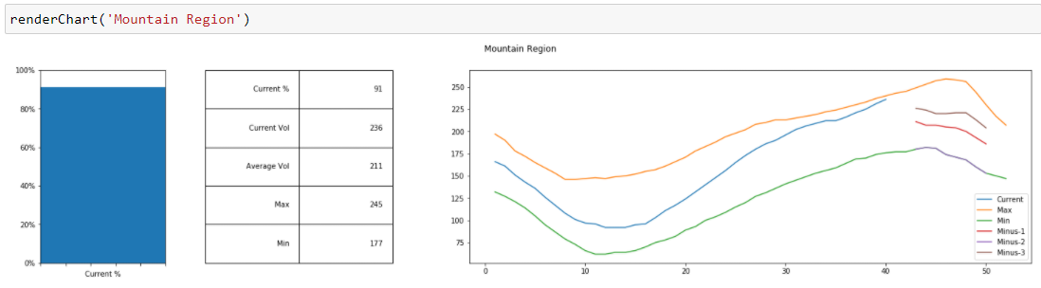
Data Assembly – Put it all Together
Notes:
MATT
This is an amazing easy to read diagram of what natural gas storage looks like today…. And it adds in the question.’if we do what we did last year… where will we be.

Slide 16
4. Scrape Predict Repeat
Notes:
PATCH
The EIA publishes a weekly number that shows how much gas flowed into or out of storage. Has anyone seen trading places? The orange forecast?... The number published Thursday of this week captures the weekly flows from 2 weeks prior. They break this info up geographically.
Can we sample storages w/ their real flow data to predict what the government number will be?

Slide 17
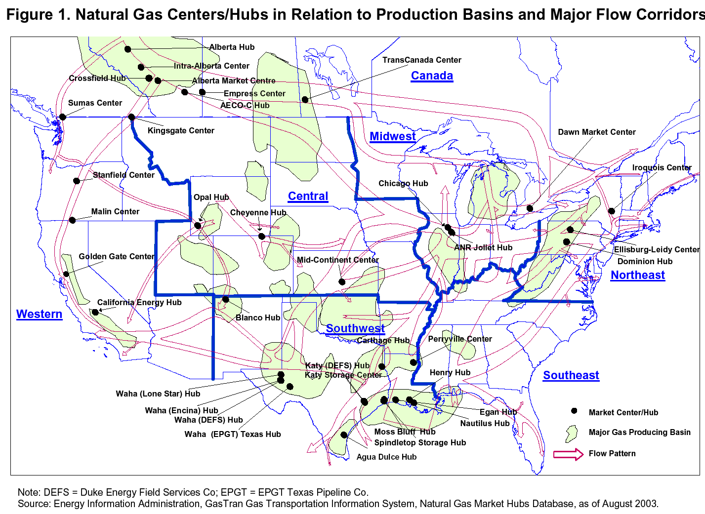
Notes:
RESUL
Every week on Thursday the government publishes a number that represents the total amount of natural gas in the ground as of the week prior. So today being the 15th, the number did come out today, and showed gas in the ground as of October 8th. You’d think it would be easy to predict but 5-6 times a year the number is very much different than what people expect. Most expectations I believed are calculated with weather, and watching certain specific larger storages in the country. However, w/ the tools we have leanred this semester scraping every possible storage is a real possibility and being right 3 times a year when other people are “wrong” would help me pay for this course.

Slide 18
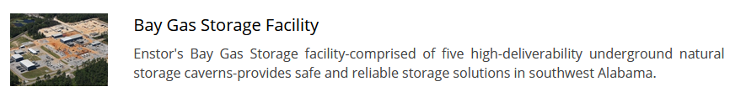

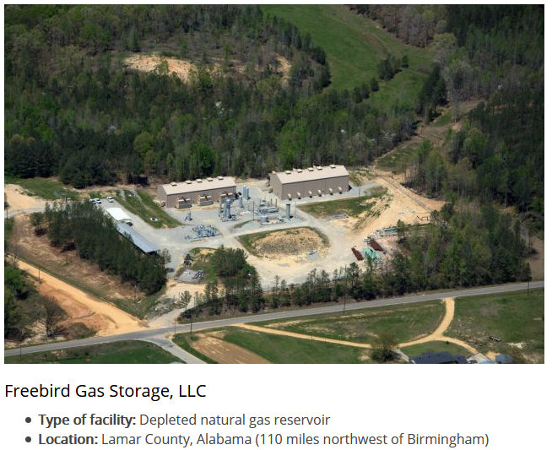

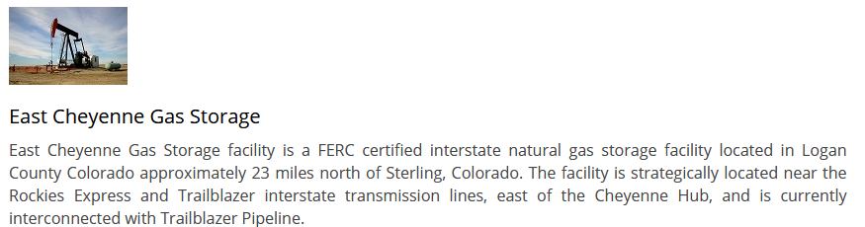
Notes:
Derek
Enstor is a company that owns a few storages across the country. We chose them because they all had a similar website set up that allowed to create one scraper to get the information we were looking for.

Slide 19
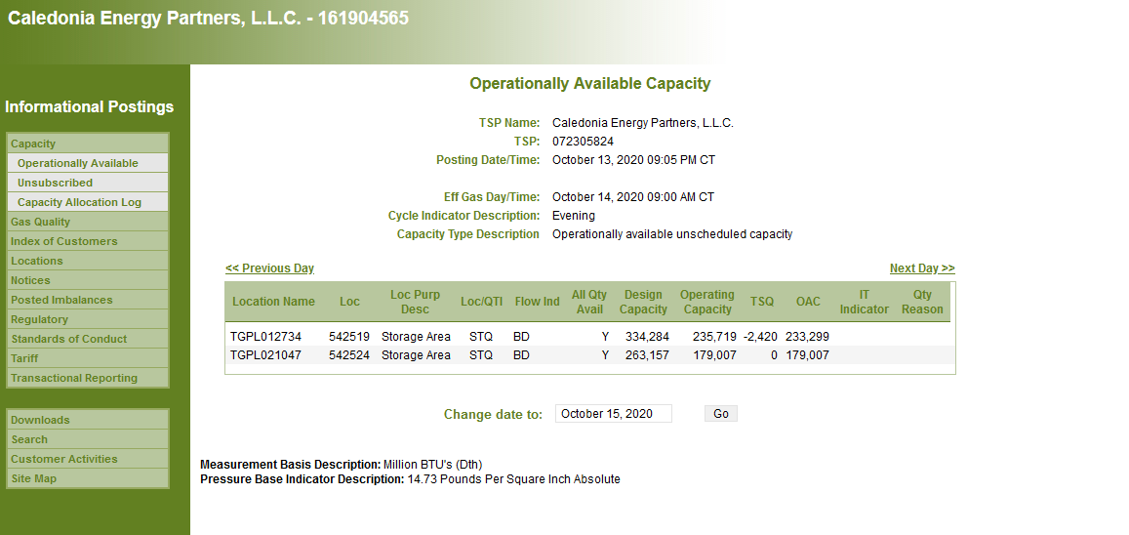
4. Scrape Predict Repeat
Notes:
MATT
This is the look that one day gives you for one storage.
We had to scrape 4 websites, combine the information into 1 day per cavern, then to match our EIA prediction sum up 7 days that end on Thursday.
Transformation to the extreme

Slide 20
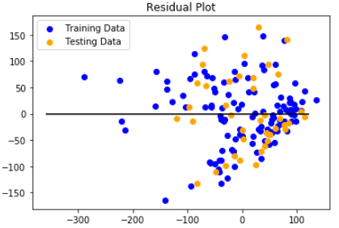

Prediction
The Training score of nearly 64% gives me hope that by adding more storages we will get this much higher
Notes:
RESUL
We chose 4 storages that are very small in comparison to the larger picture of natural gas storage. Also are storages area bit more focused in the southeast and the EIA number is the CONUS in total. This was expected. This is a great first step.

Slide 21
5. Conclusion
Notes:
We now have the tools to make predictions for fundamental numbers in natural gas. This will make me better understand the market in front of me. I can view storage as it sits today and where it would be if we follow prior years past, and I am most excited that we brought all our tools together for our final step. The EIA number is a weekly test of our skills now and I’m excited to get the number higher.

